Slide 1
DevConnect
Making developer’s lives easier one bug at a time
By:
Danesh Vijay Dhamejani Harshala Ashok Doiphode Karan Pinakinbhai Jariwala Yusuf Juzar Soni
Advisor:
Professor Dan Harkey
CMPE 295-B December 2022

Slide 2
Meet John..
John was a marketing executive who wishes to get into programming and web development. John has recently enrolled into a coding bootcamp and just started learning the basics. The initial few weeks of the bootcamp have been relatively easy and have gotten John really excited to explore more…
Johns instructor has given him an assignment which is due in the coming weeks. The assignment contains a question that John can’t quite understand… John does what we all do when we are stuck nowadays. All hail the WORLD WIDE WEB !!!

Slide 3

Information Overload !! Stawp !!
John tries to look for a solution to his question, but is really overwhelmed by the amount of information presented on the Internet. Seeing too much information has confused him even further , and John is worried he might not beagle to turn in his assignment on time. John wished he had a simple easy to use platform where he could find his answer quickly without too much auxiliary information, but is unable to do so … That’s where the need for a simple easy to use Q&A platform with social media capabilities built in comes in handy.
Presenting..
DevConnect: Making developer lives easier one bug at a time !!

Slide 4
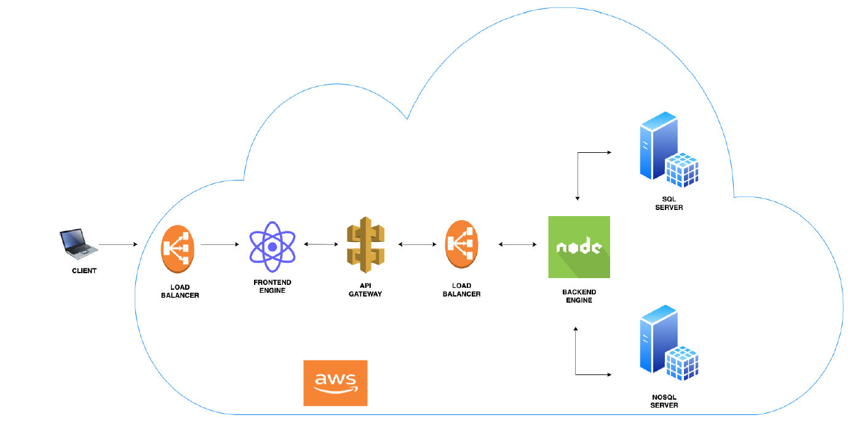
Architecture

Slide 5
Features
Everything at one place.
Create posts with images to ask queries in specific groups.
Comment on posts and upvote/downvote accordingly.
Search posts.
Join and Create communities related to a specific language/technology.
Real time direct chat with friends.
Create and participate in hackathons.
View hackathon details and participating members and connect with them.
Create and apply to job postings.
Advertising display

Slide 6
Demo
Paste demo video link

